Slide 1

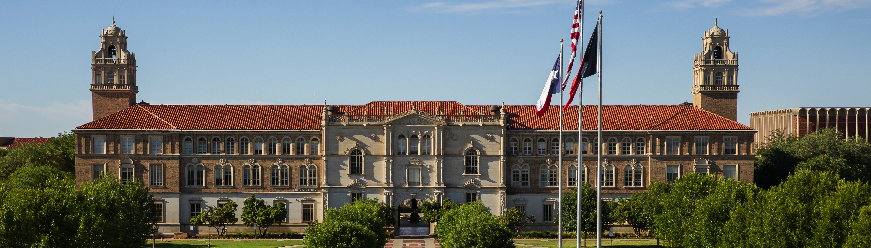

PROJECT 5
Presentation
ECE 4367
NichOLAS rETHANS & sAMIR hOSSAIN

Slide 2
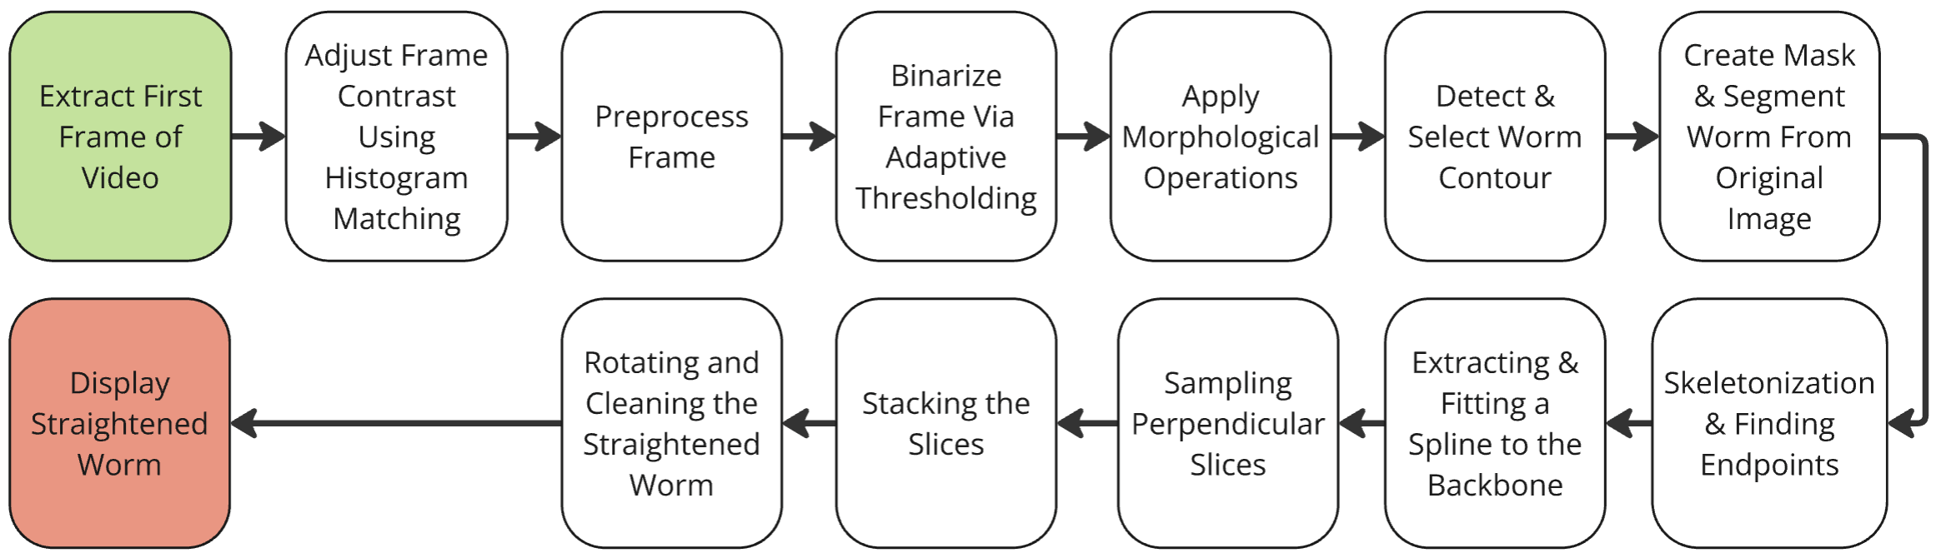
High Level System Diagram

Slide 3
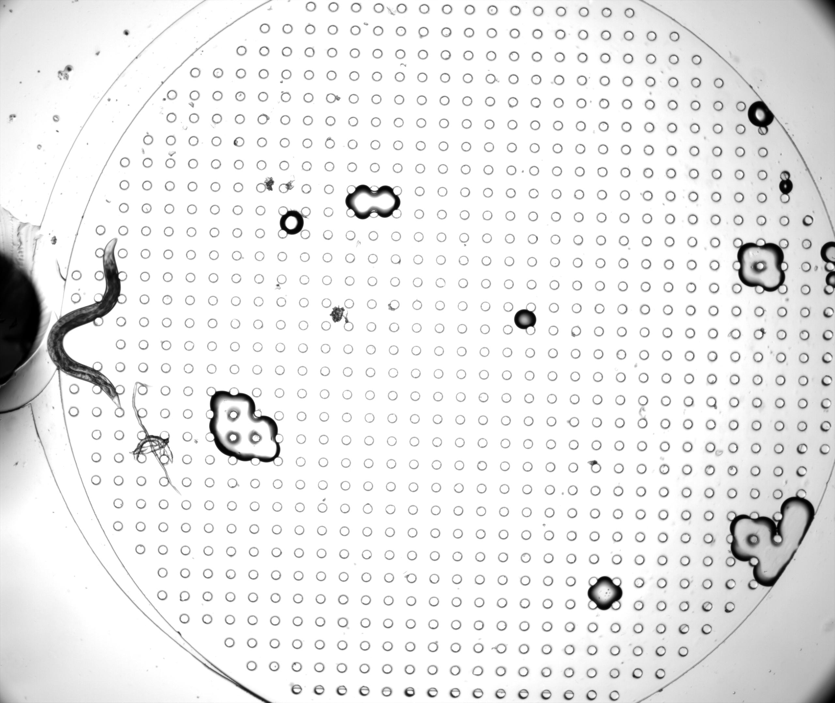
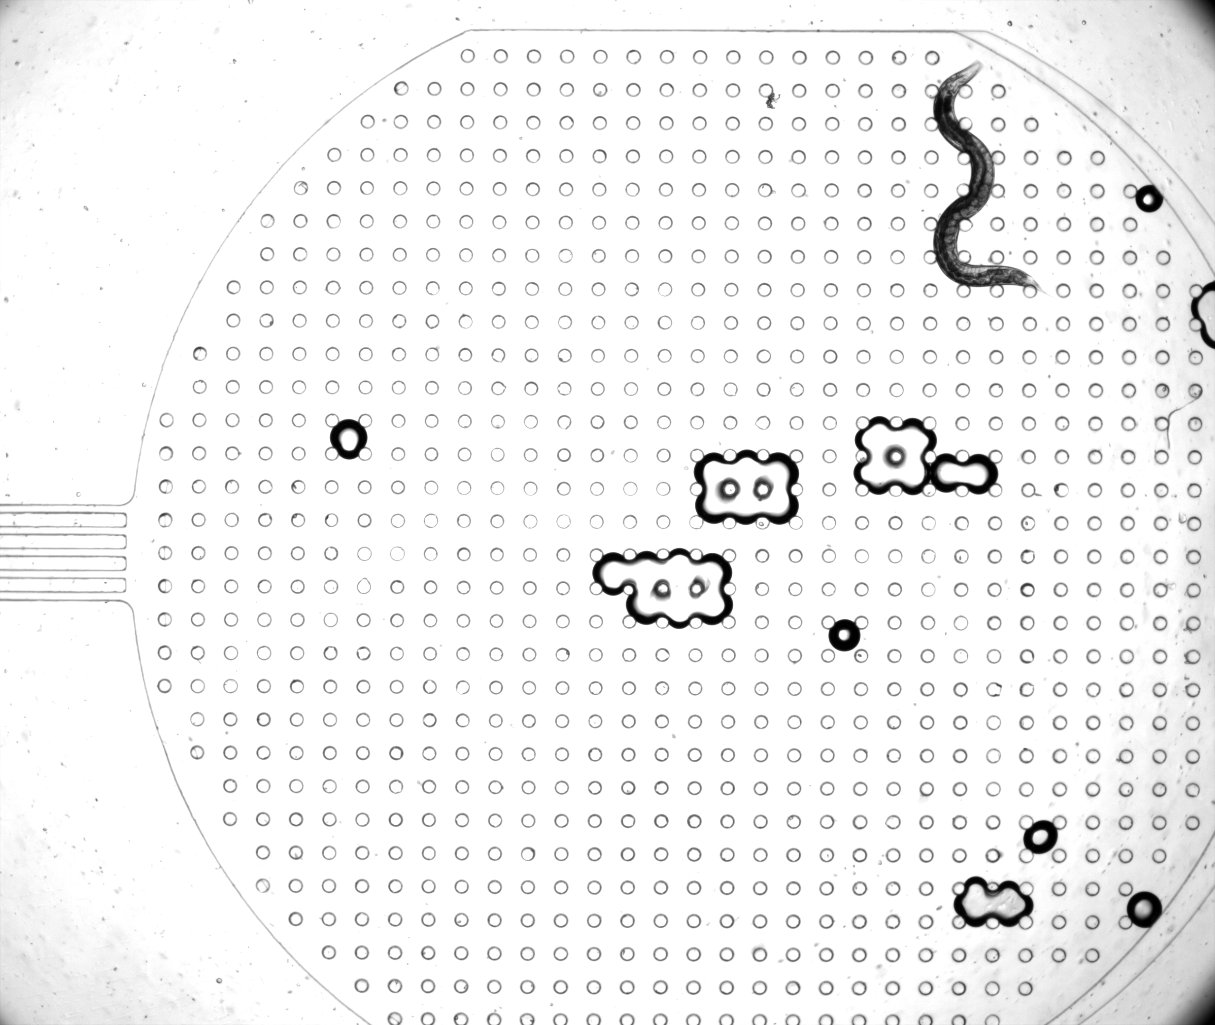
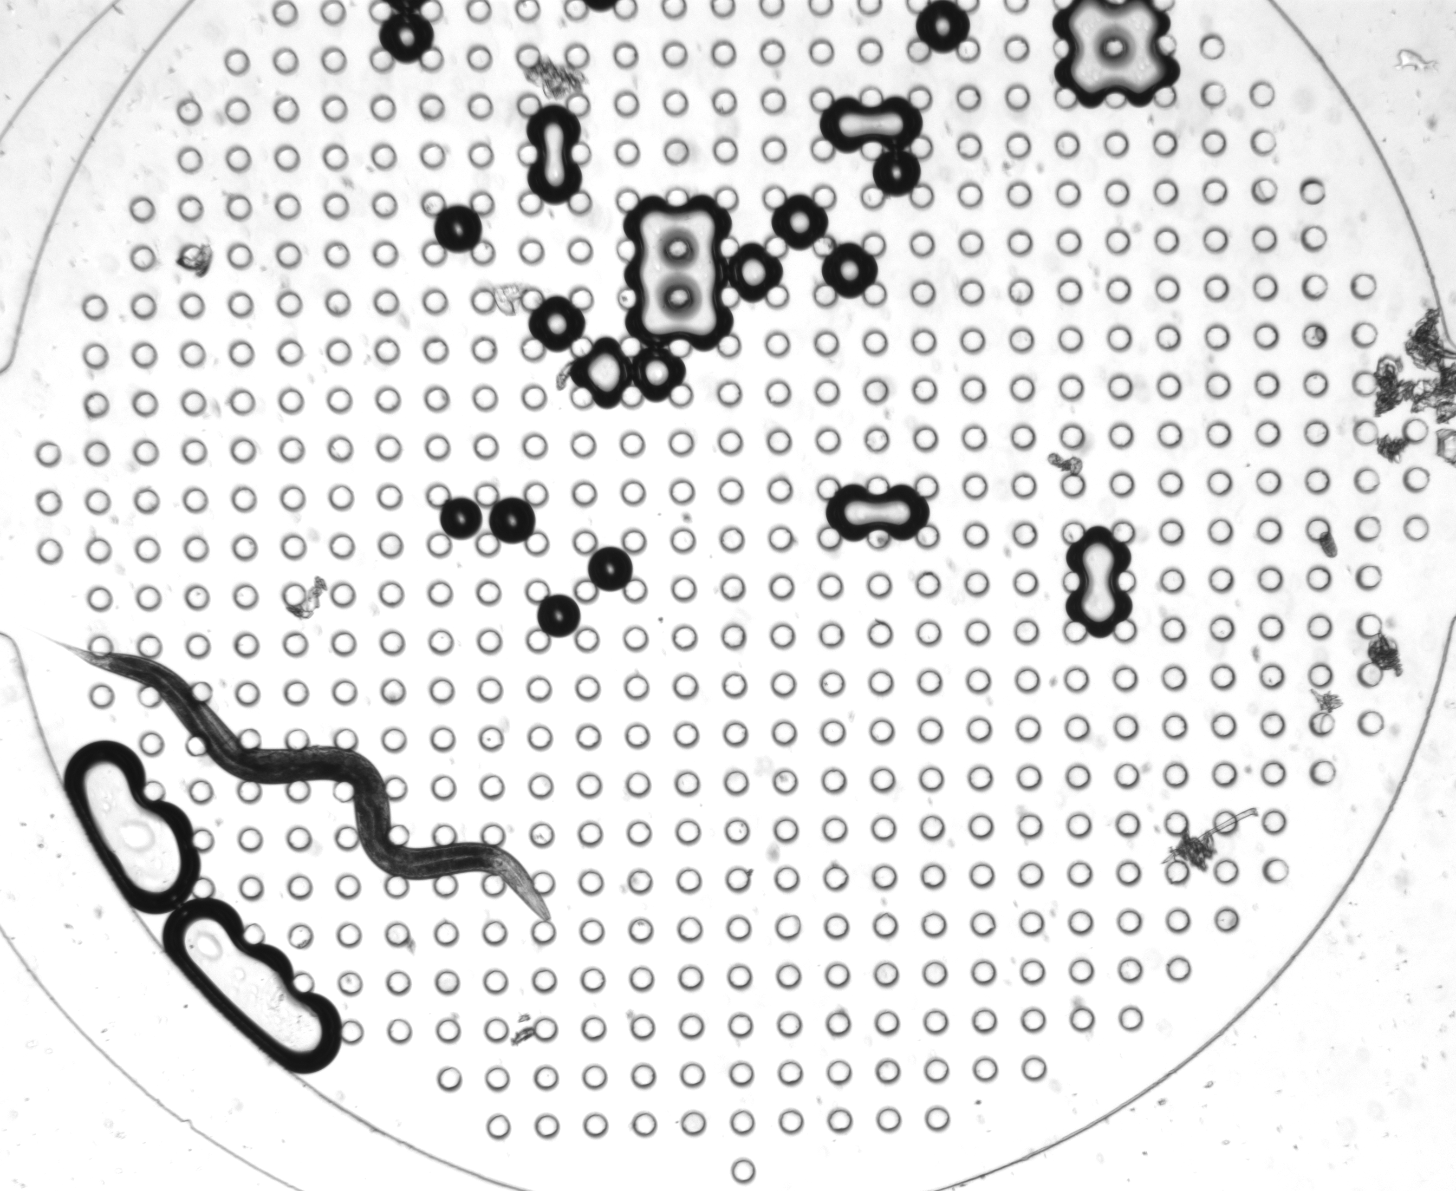
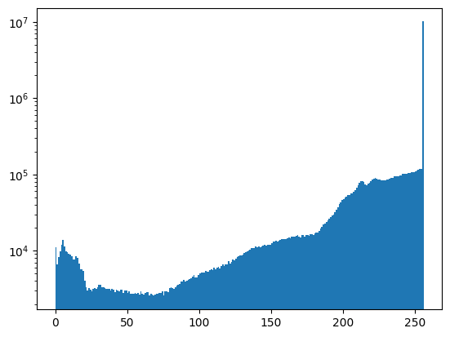
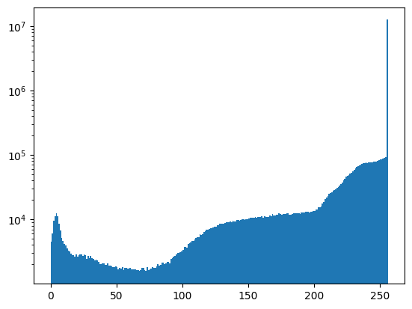
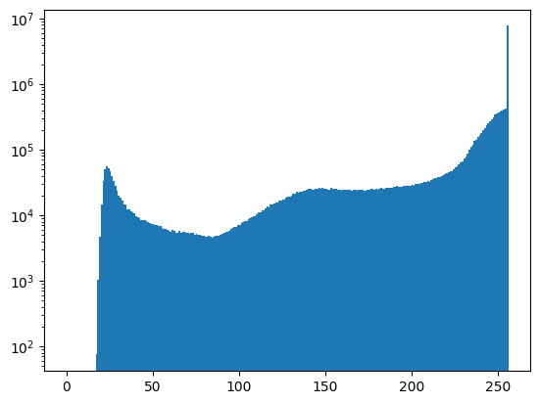
Image Intensity Histogram Matching
BZ33C_Chip1D_Worm27 (Worm 1)
BZ33C_Chip2A_Worm06 (Worm 2)
WT_G10_03 (Worm 3)
Problem: Worm 3 has a low intensity cutoff while Worm 1&2 do not.
This caused issues with thresholding and morphology processes later in the program.
The Kolmogorov-Smirnov Test indicates whether two datasets (images) come from the same distribution.
Notes:
Remember: The normalized hist is a PDF The KS test looks at the biggest difference between two cumulative distribution functions (CDFs). The CDF of a dataset tells you, for any value, what proportion of the data is below that value.
If two distributions are similar, their CDFs will line up closely.
If two distributions are different, their CDFs will diverge, and the test identifies the largest gap between them
The KS test returns two values the d statistic (K-stat) and the Pval.
The D-statistic is the maximum absolute difference between the cumulative distribution functions (CDFs) of the two datasets (or between the dataset's CDF and a theoretical CDF).
It measures the largest discrepancy between the two distributions.
Range: 0≤D≤1 .
D=0 The two distributions are identical.
Larger D: Greater differences between the distributions.

Slide 4
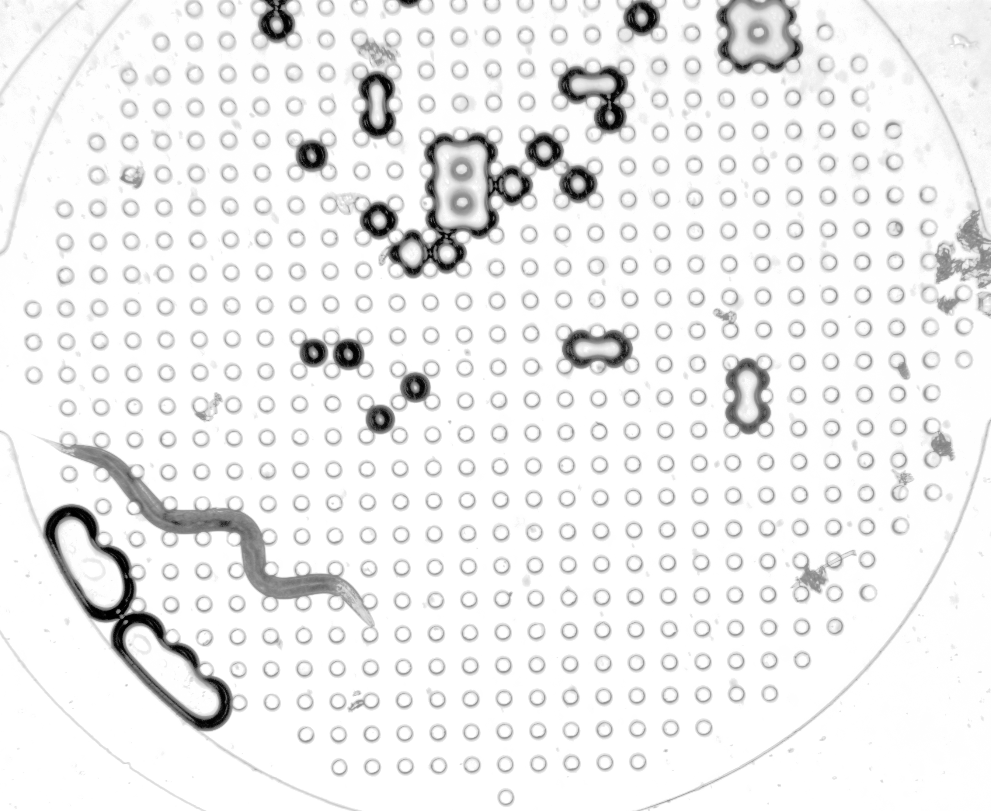
Image Intensity Histogram Matching
1-D linear interpolation was used to re-map the Worm 3 CDF to the average CDF of Worms 1&2

Slide 5
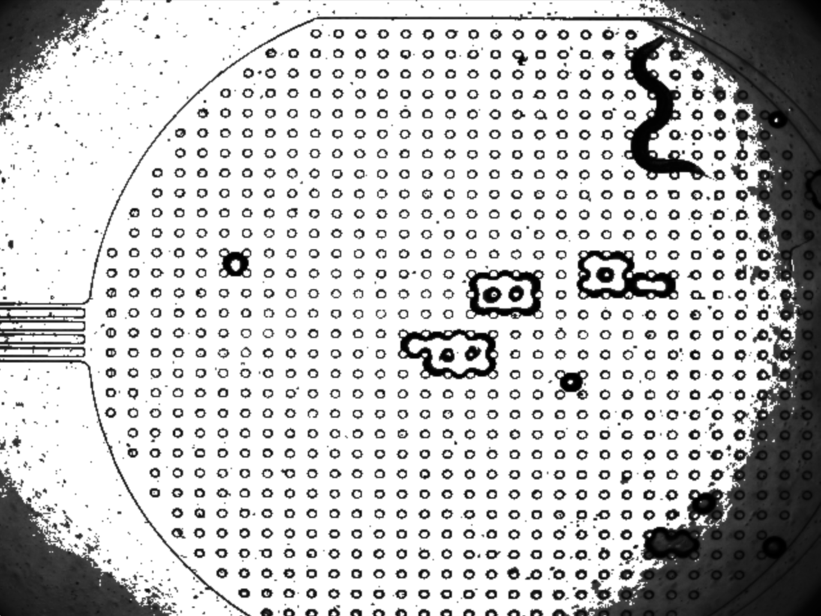
Worm Segmentation (Preprocessing) Pt1.
Worm 2: Unprocessed
Worm 2: Histogram Equalization
Nicholas 5

Slide 6
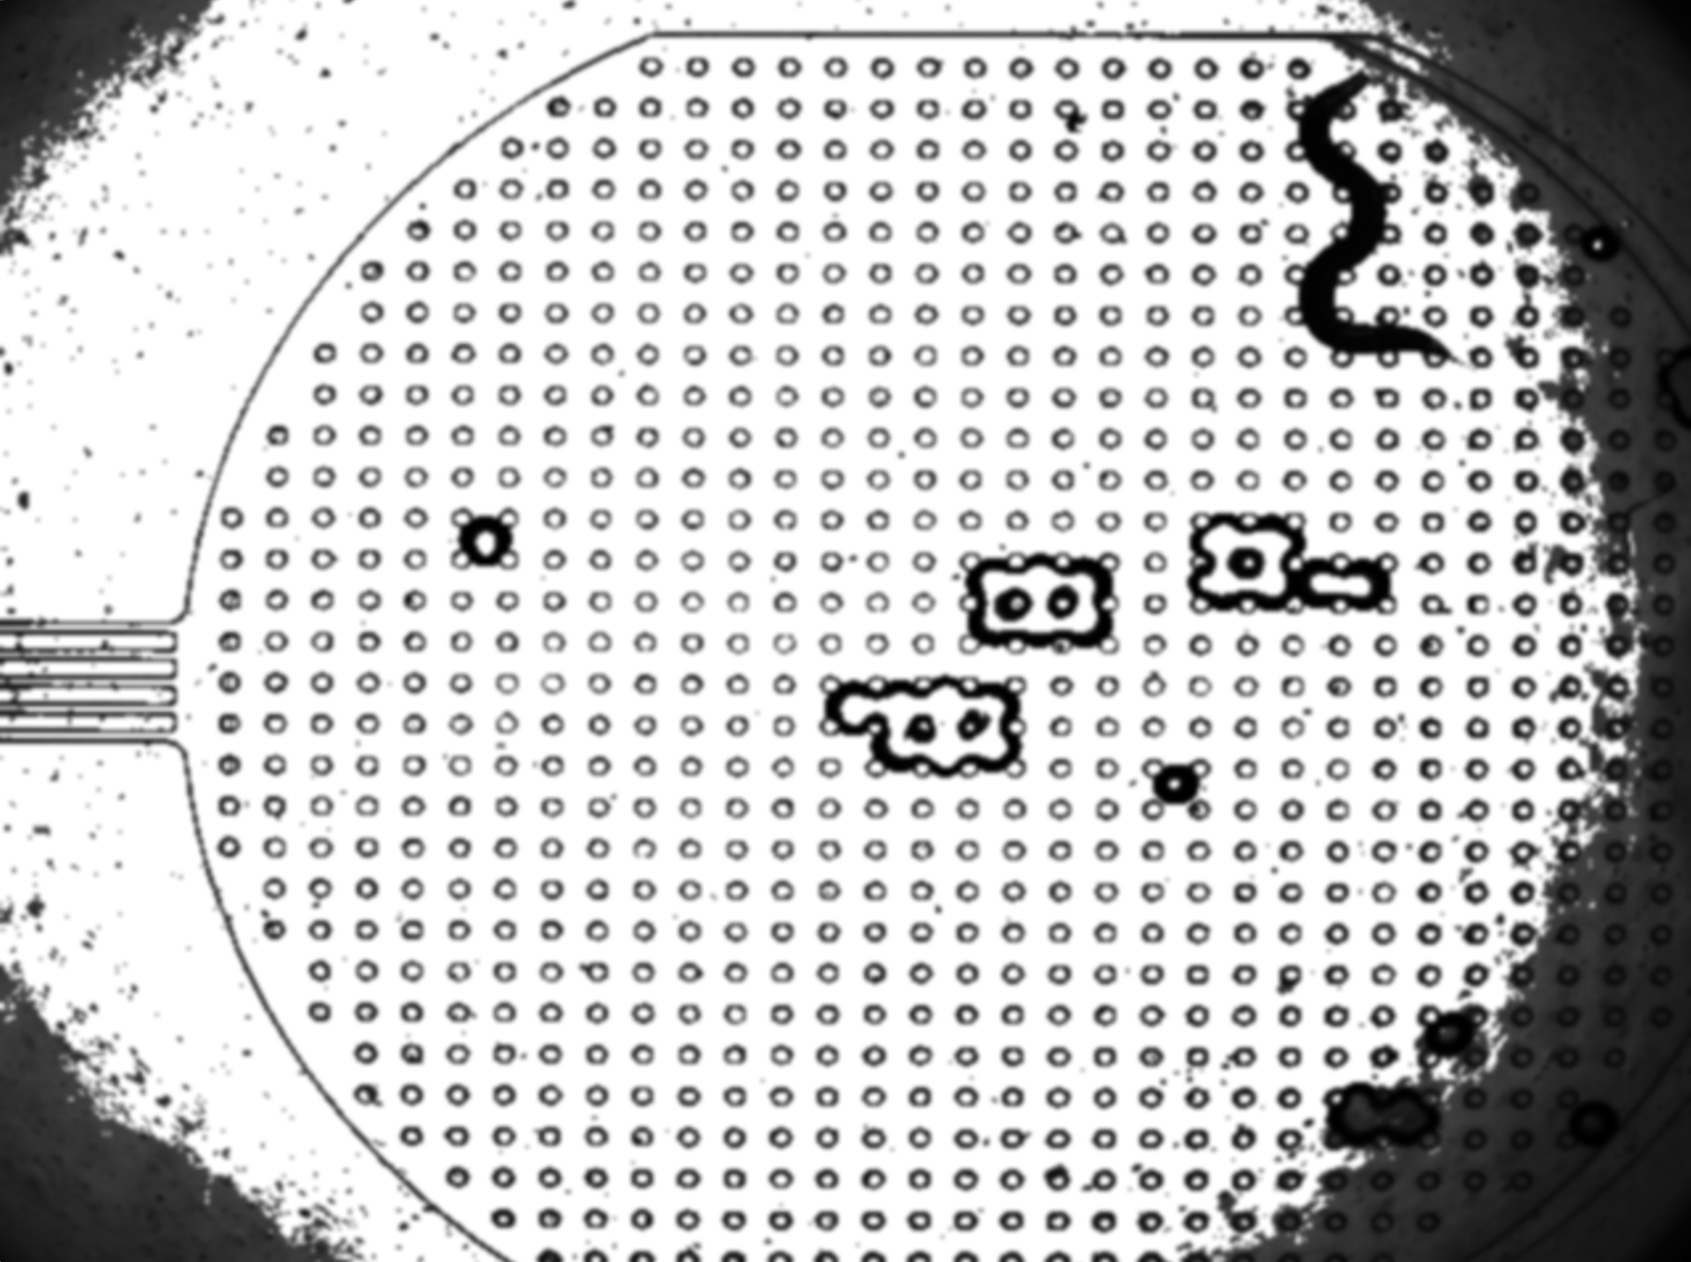
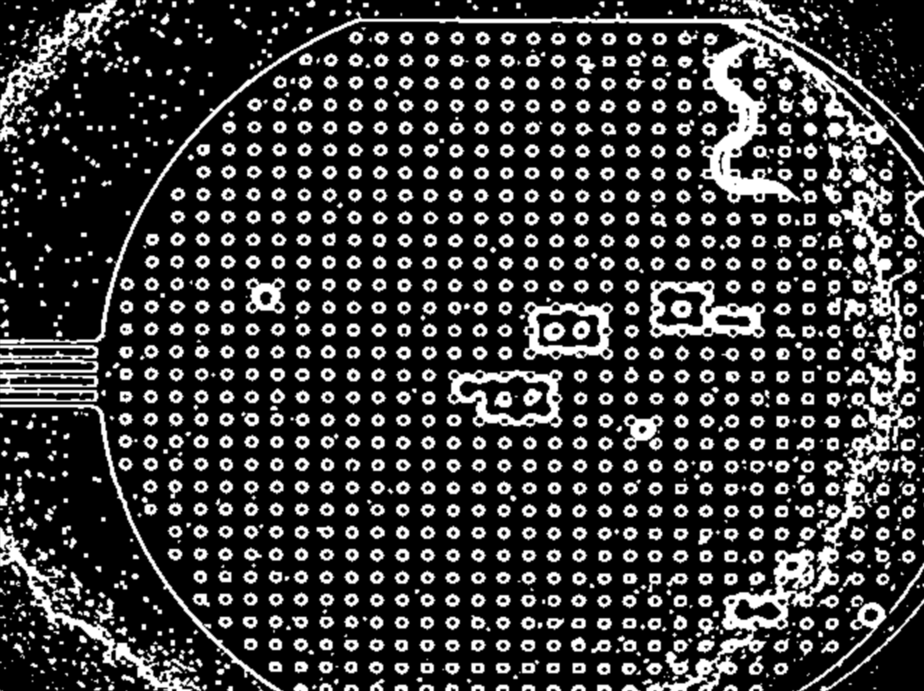
Worm Segmentation (Preprocessing) Pt2.
Worm 2: Gaussian Blur With 3x3 Kernal
Worm 2: Binarized Using 15x15 Adaptive Gaussian Weighted Sum Thresholding (Inverted)
Nicholas 6
Notes:
The adaptive thresholding algorithm to use. In this case, cv2.ADAPTIVE_THRESH_GAUSSIAN_C is used, which means the threshold value is calculated using a Gaussian-weighted sum of the neighborhood values minus the constant (set to 3) The idea is that it will preserve fine details especially around the head and tail of the worm.

Slide 7
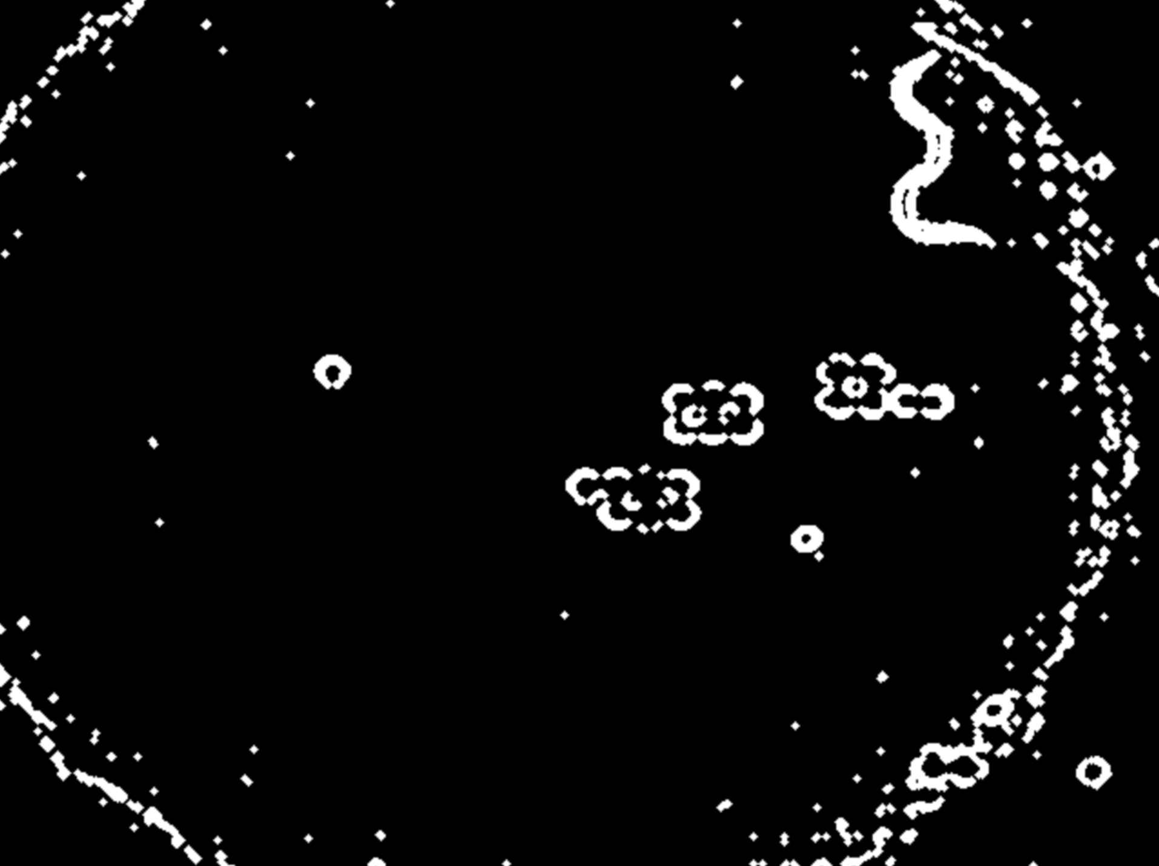

Worm Segmentation Pt3.
Worm 2: Opening Using 3x3 Ellipse (Twice)
Worm 2: Mask selected based on contour with largest arc length & aspect ratio.
Notes:
The aspect ratio is just the height and width of the bounding box of the worm. This approach worked better than using the area of the worm because of the debris in some frame were thick blobs which had high area after binarization.

Slide 8

Worm Segmentation Pt4.
Worm 2: Mask smoothed using 5x5 median filtering.
Worm 2: Mask selected based on contour with largest arc length & aspect ratio.
Nicholas 8

Slide 9
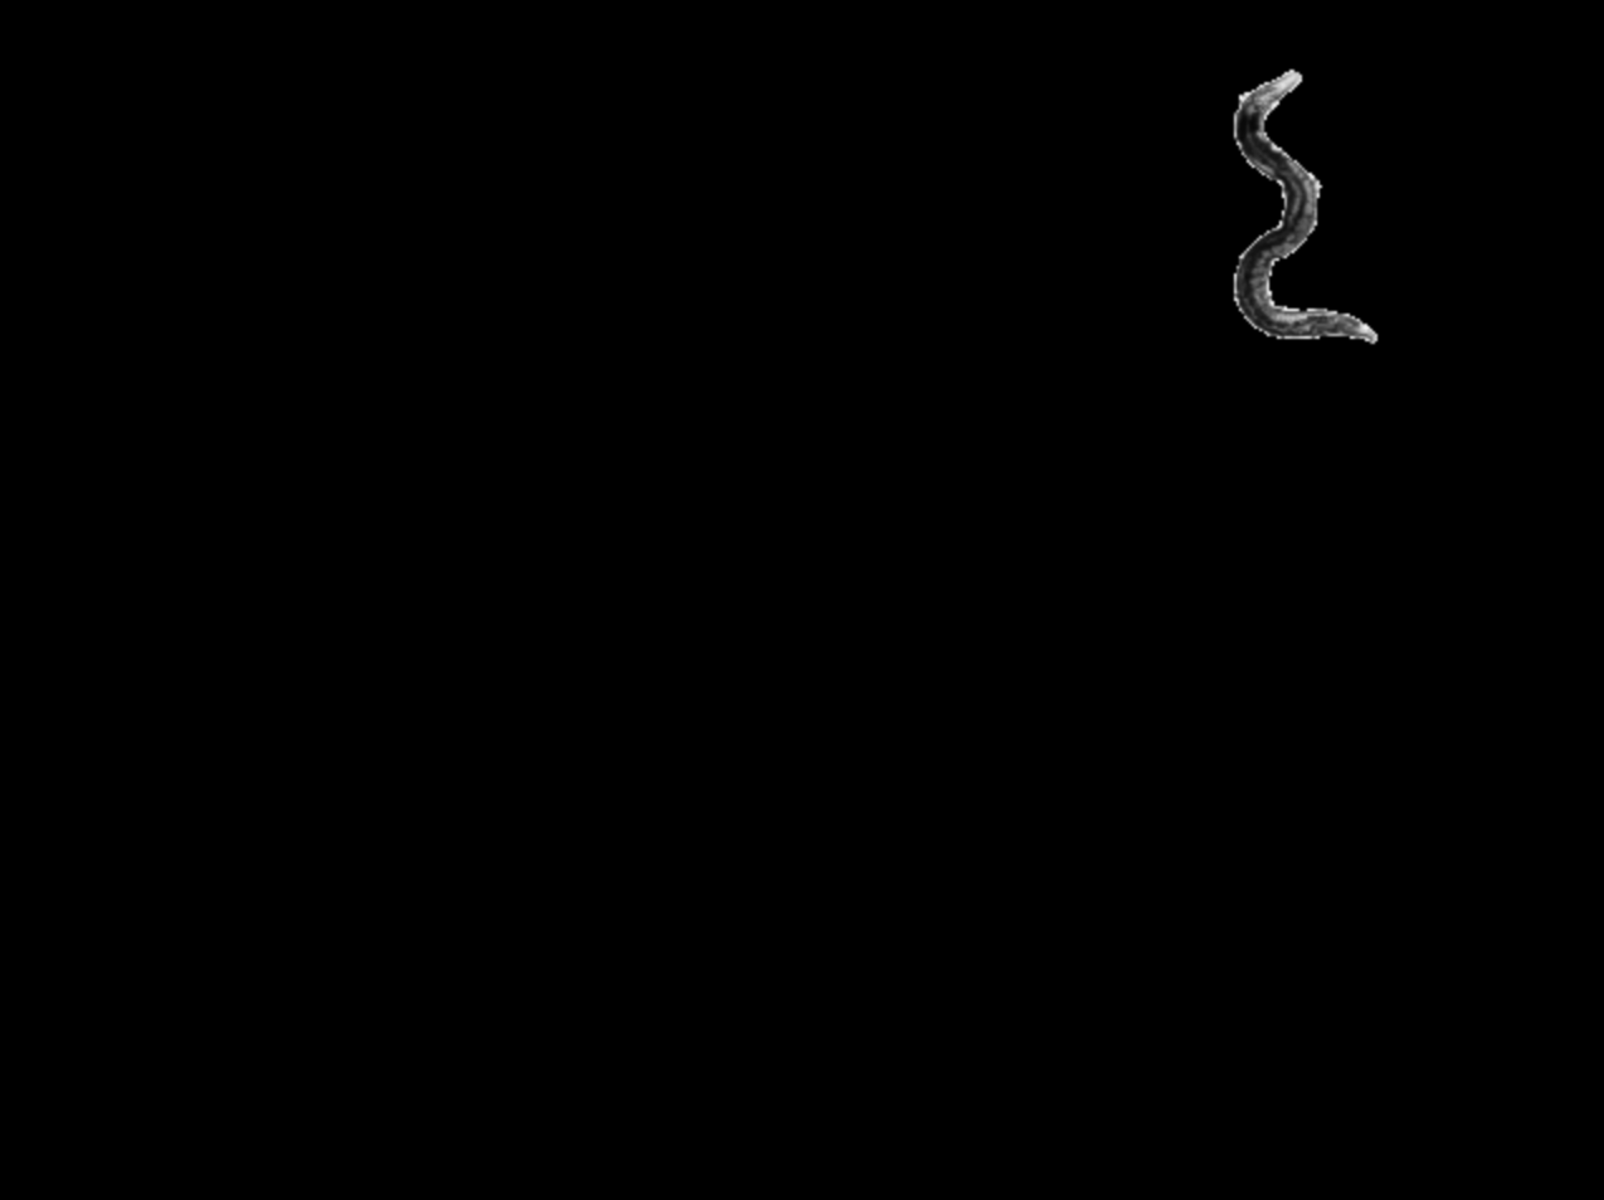
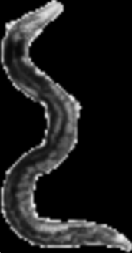
Worm Segmentation Pt5.
Worm 2: Original frame masked
Worm 2: Cropped
Nicholas 9

Slide 10

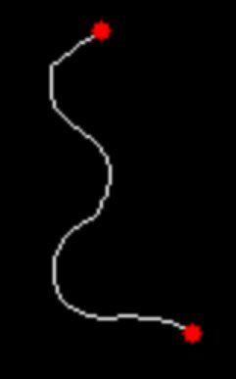
Skeletonization & Finding Endpoints
The binary mask is reduced to a single-pixel-wide skeleton representing the worm’s centerline
Endpoints, marking the worm’s tips, are identified on the skeleton.
Samir 10
Notes:
We skeletonize the worm mask to extract its centerline. This skeleton provides a single-pixel-wide representation of the worm, which will serve as the foundation for extracting the backbone. Endpoints are detected as skeleton pixels with only one neighbor. These points represent the worm’s head and tail, which are crucial for defining the backbone.

Slide 11
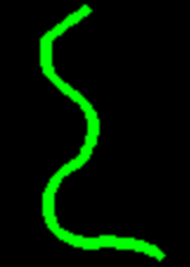
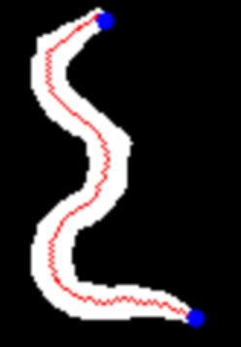
Extracting & Fitting a Spline to the Backbone
The longest path between endpoints becomes the worm’s backbone.
A smooth spline is fit through the backbone points to define the worm’s centerline. Backbone ends are extended to ensure the worm’s tips are fully captured.
Samir 11
Notes:
To extract the backbone, we calculate the longest path between the two furthest endpoints along the skeleton. This path represents the worm’s central axis. We fit a smooth spline through the backbone points. The spline provides a continuous and smooth representation of the worm’s centerline, which is essential for precise sampling. To avoid clipping the worm’s tips, we extend the backbone spline beyond its detected endpoints. This ensures that the head and tail are included in the straightened image.

Slide 12
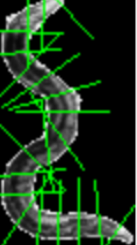
Sampling Perpendicular Slices
Algorithm:
For each point along the backbone (defined by the spline), calculate the tangent vector.
Compute the perpendicular direction.
For each perpendicular direction, sample pixels outward until the boundaries of the worm mask are reached.
Each slice captures the worm’s thickness at that point, ensuring the body is fully covered.
Perpendicular slices across the worm form the building blocks for straightening.
Samir 12
Notes:
At each point along the spline, we compute a perpendicular direction and extract a thin slice of pixels. These slices represent cross-sections through the worm and are the building blocks for straightening.

Slide 13
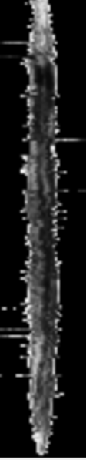
Stacking the Slices
Algorithm:
Vertically stack all the slices extracted in the previous step.
Each slice corresponds to a horizontal row in the straightened image.
The stacking order preserves the spatial relationship of the worm’s body from head to tail.
"The slices are stacked to create a straightened image of the worm."
Samir 13
Notes:
We stack the perpendicular slices vertically to reconstruct the worm in a straightened format. The worm’s curvature is removed, leaving a clear, linear representation.

Slide 14
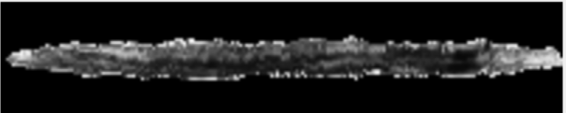
Rotating and Cleaning the Straightened Worm
The straightened image is rotated and cleaned to remove artifacts.
Algorithm:
Rotation:
Rotate the straightened image by 90° clockwise so the worm appears horizontal.
Mask Cleaning:
Apply binary thresholding.
Perform morphological operations (e.g., opening) to remove noise.
Use median filtering to smooth the edges.
Apply the mask to the original stacked worm.
Samir 14
Notes:
The straightened worm is rotated 90° to align it horizontally. We clean the mask using morphological operations and filtering ensuring the final image is free from artifacts.

Slide 15
Resources
[1] OpenCV, "OpenCV Documentation," OpenCV.org, Accessed: Dec. 6, 2024. [Online]. Available:https://docs.opencv.org/4.x/index.html
[2] H. Peng, F. Long, X. Liu, S. K. Kim, and E. W. Myers, "Straightening Caenorhabditis elegans images," Bioinformatics, vol. 24, no. 2, pp. 234–242, Nov. 2007, doi: 10.1093/bioinformatics/btm569.
Samir 15

Slide 16
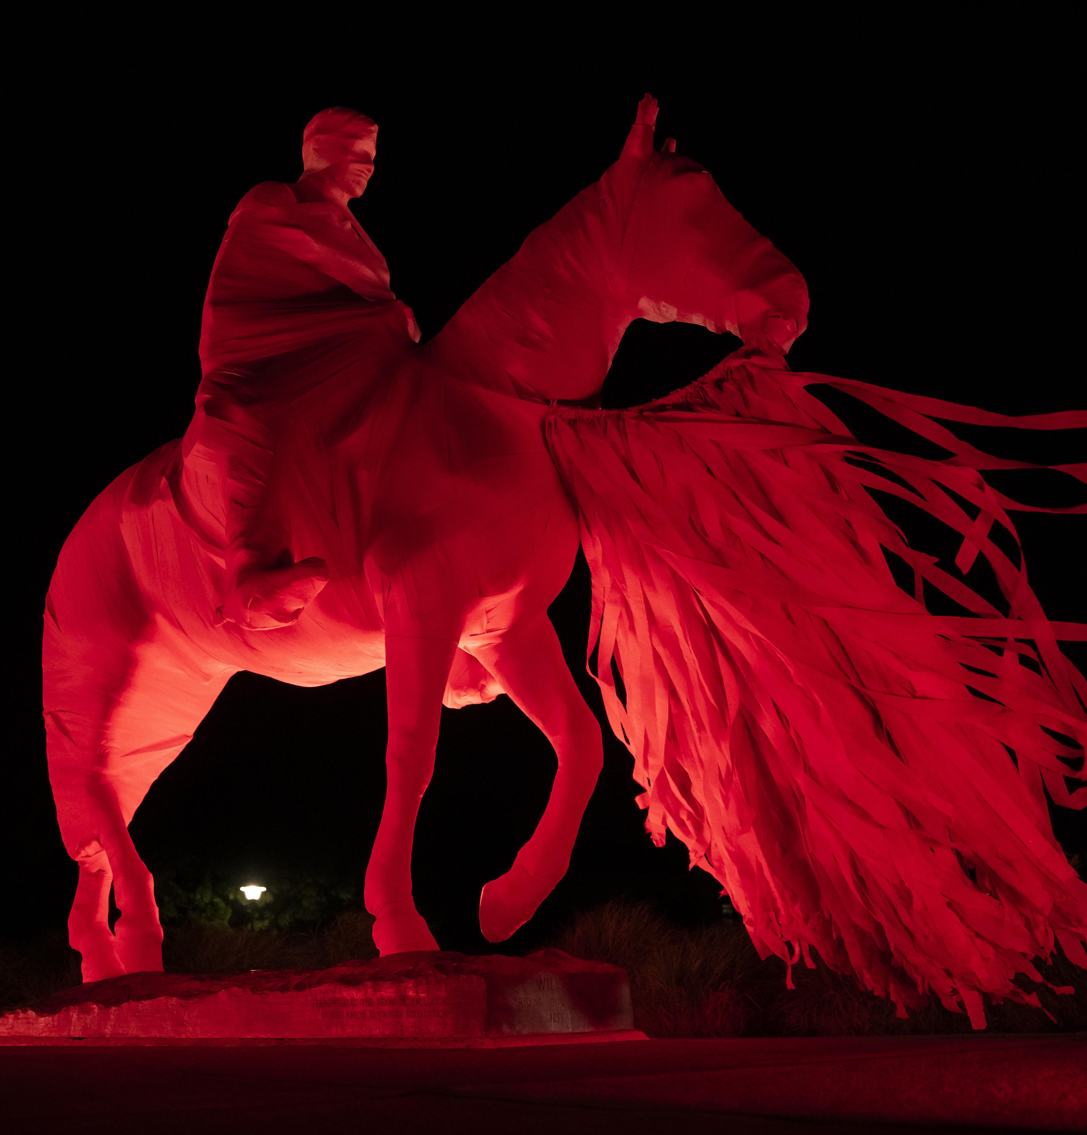

Questions?

